Slide 1

Deccan Education Society’s FERGUSSON COLLEGE(AUTONOMOUS), PUNE - 411004
Department Of Computer Application
A
PROJECT PRESENTATION
ON
“Placement Management System”

Slide 2
Welcome To Placement Management System
Submitted By Name Roll No 1.Nishant Shete 601 2.Dipak Pawar 580 3.Arjun Patekar 572
Under the Guidance of :- “Prof.Ankur Sir.”

Slide 3
Contents:
Existing System
Input Screens
01
04
ProPosed system
Output screens
02
05
Technologies Used
03
06
Reports
Placement Management System
3
Notes:
© Copyright Showeet.com – Creative & Free PowerPoint Templates
3

Slide 4
Contents:
07
Limitation or drawbacks
09
Future Scope
08
10
conclusion
Bibliography
Placement Management System
4

Slide 5
01
Existing System
In the existing system lead to many problems .These are as follows
Problems in existing system
Maximum manual work: in the existing system all the work that is done by human intervention. Humans should do all the work.
Maximum human interface: the interface between the student and administrator is maximum.
Time consuming: due to above problems every procedure becomes time consuming.
File system: the records were stored in modified access sheets hence sorting problem.
Updating records: due to above problems the updating was very difficult and ambiguous.
Less alertness: the students may not get the information on placement activity hence they miss the opportunities.
Alumni record: the past students records are not maintained.
5

Slide 6
02
Proposed System
Admin Module:-
Once the admin logins, they will be able to view and delete registered students.
Admin can add the new company and also update & delete the company.
Admin can view all company.
Admin can search by company name who apply the specific company and view all students.
Student Module:-
After login, the student should be able to view of list of company.
Student can apply the company.
Student can edit/update their details.
Student can ask their queries.
6

Slide 7
02
Proposed System
Head Module
Once the head login, head will view the selected students.
Head can view students quires.
Head can reply student quries.
7

Slide 8

03
Technologies used for Project
Technologies:-
Frontend –Bootstrap5,HTML,CSS
Backend – PHP,MYSQL
8

Slide 9
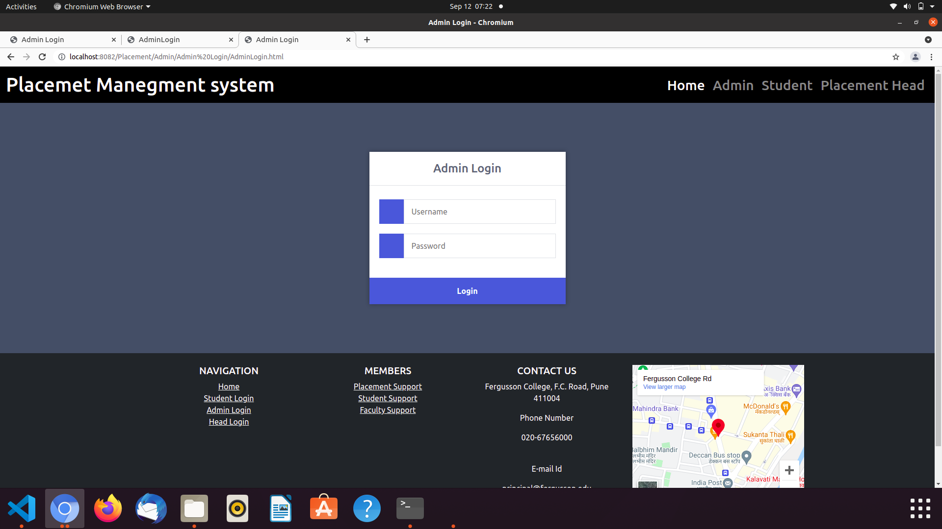
04
Input Screens
Admin Login
9

Slide 10
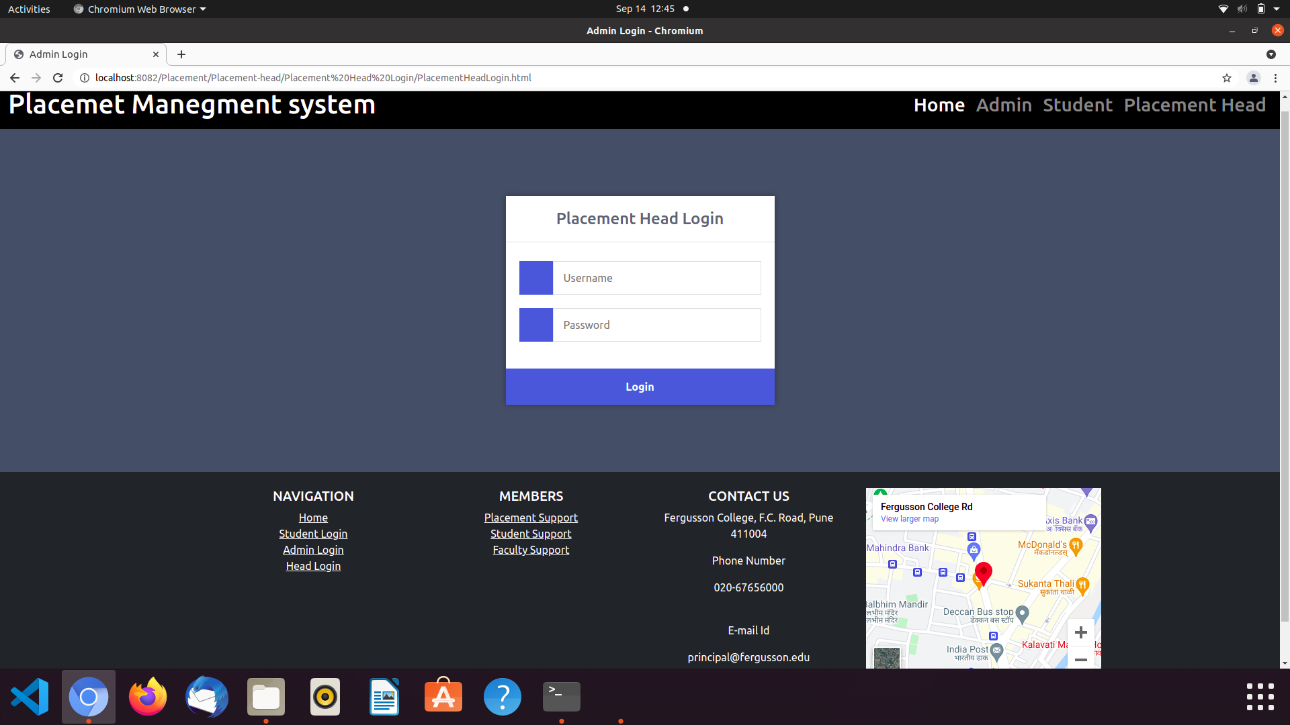
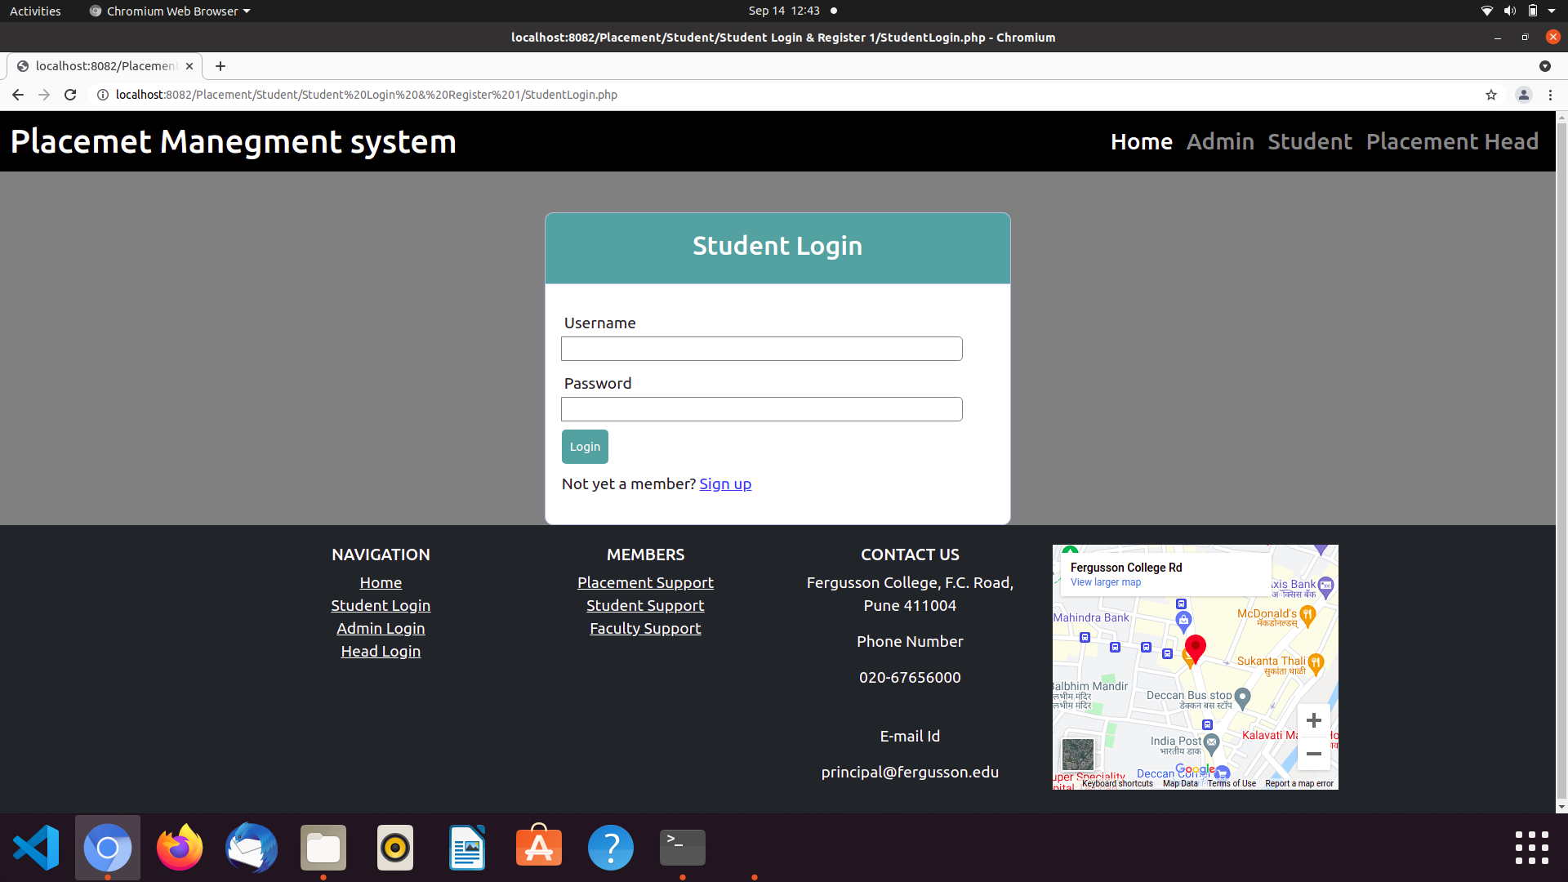
Head Login
Student Login
10

Slide 11
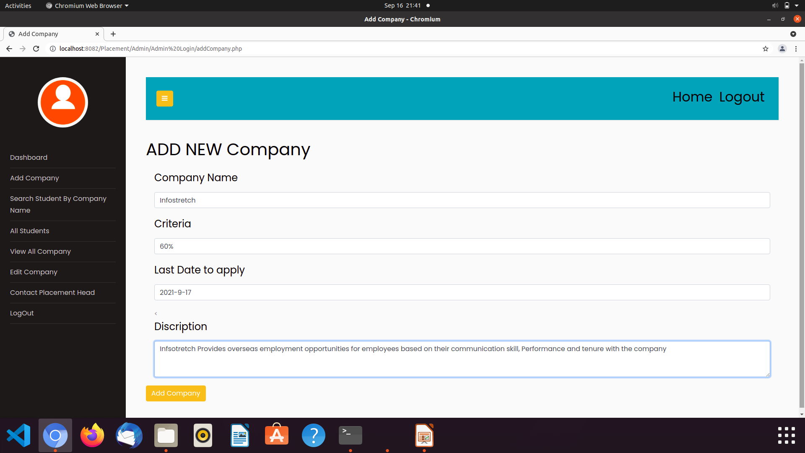
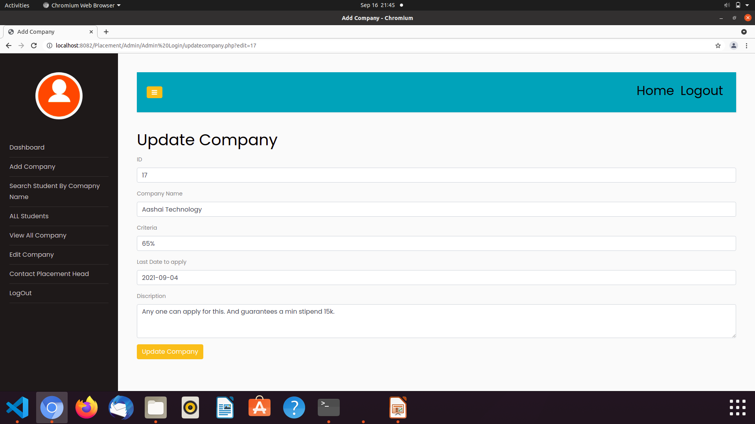
Admin
Add New Company
Update Company

Slide 12
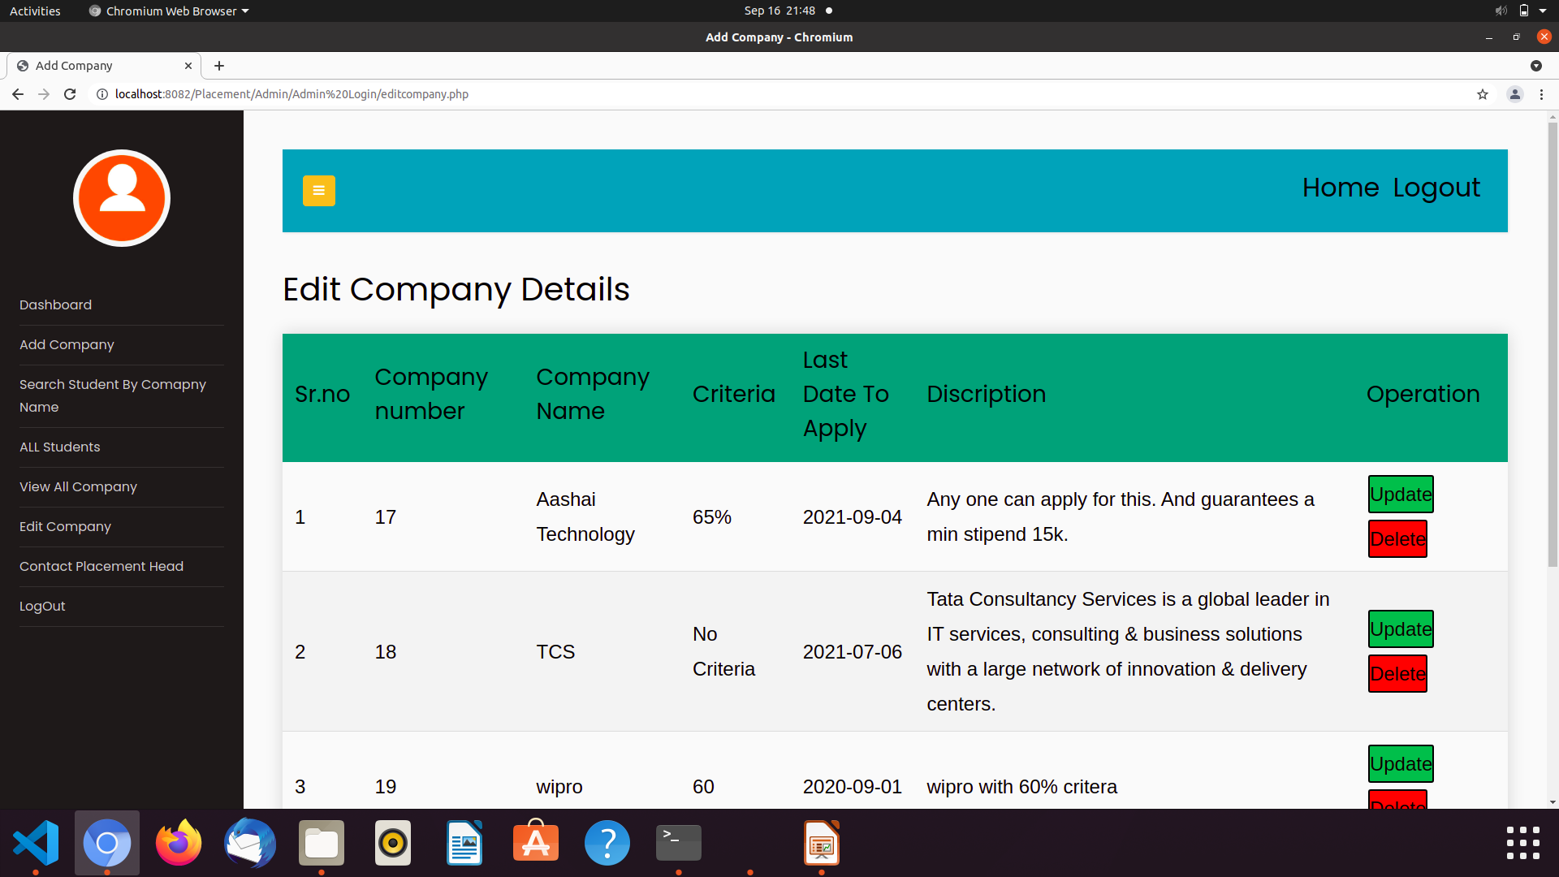
Edit Company Details

Slide 13
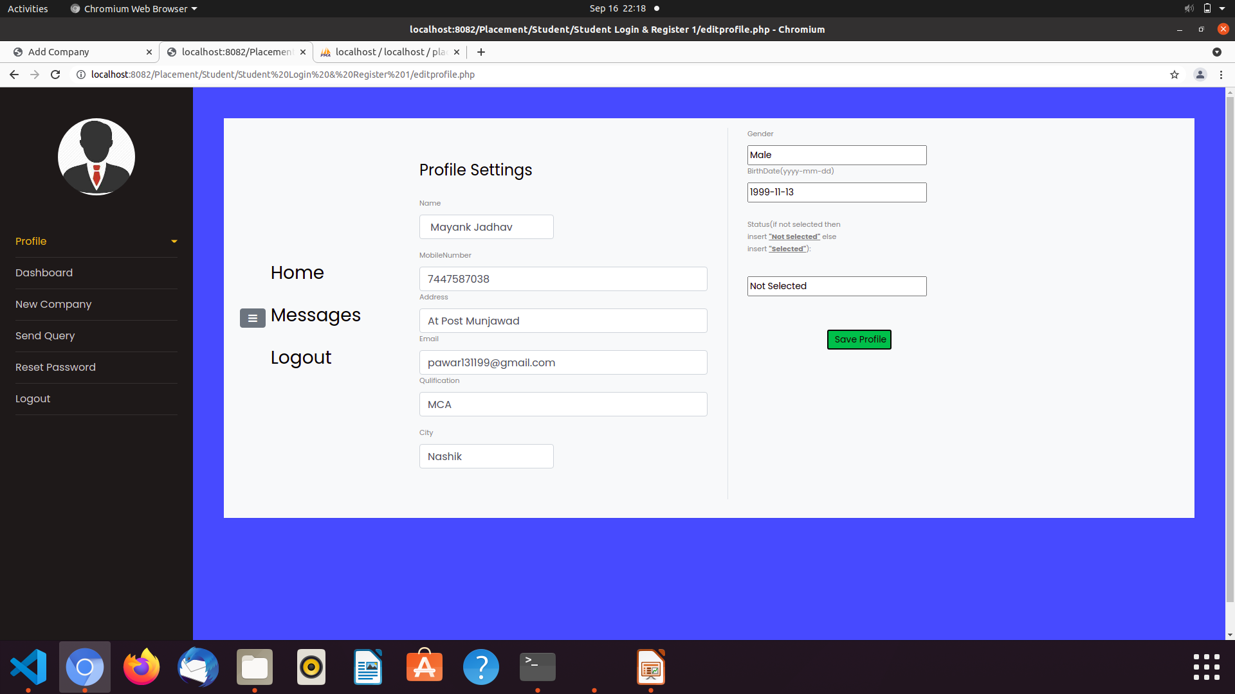
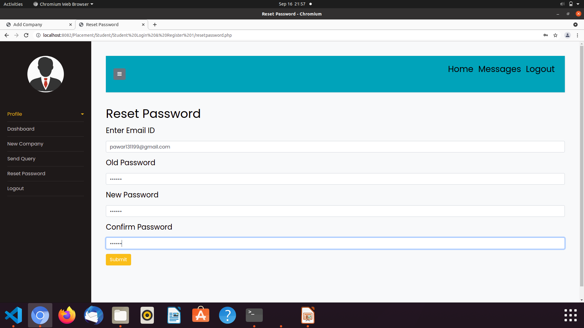
Student
Edit Student Profile
Reset Password

Slide 14
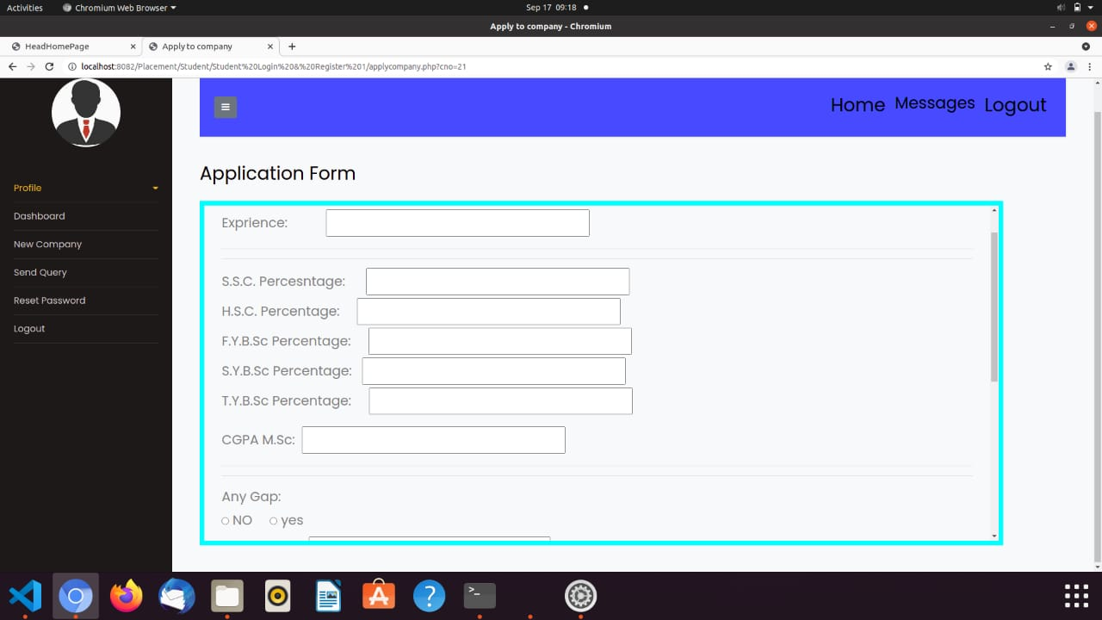
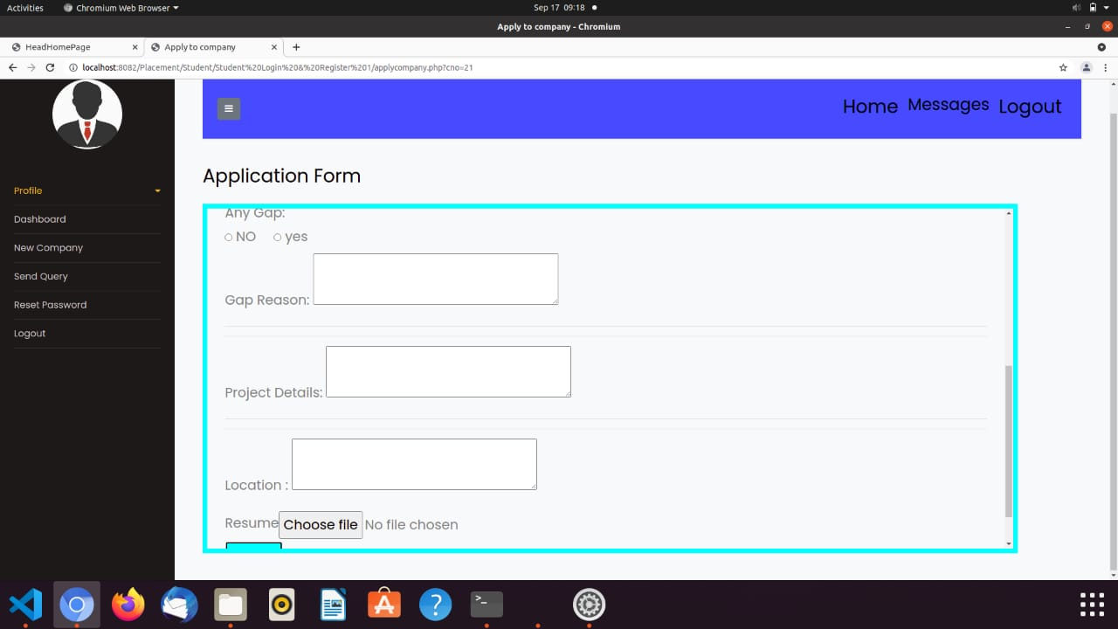
Apply Form

Slide 15
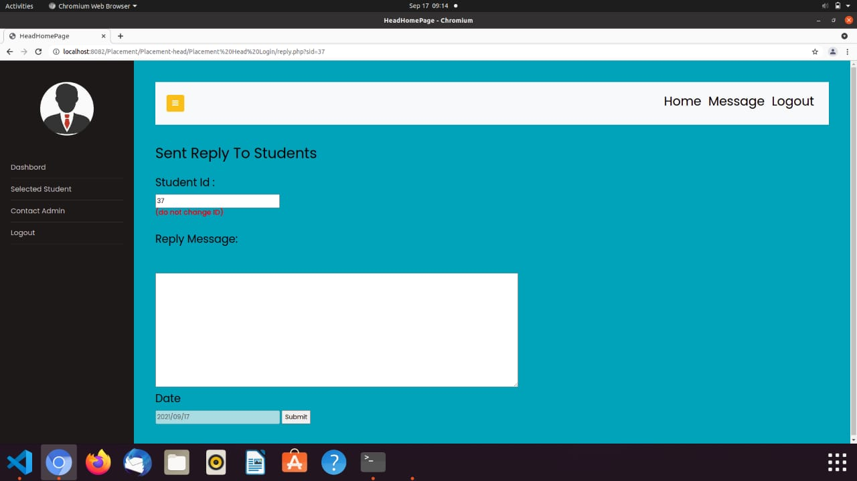
Reply to Student

Slide 16
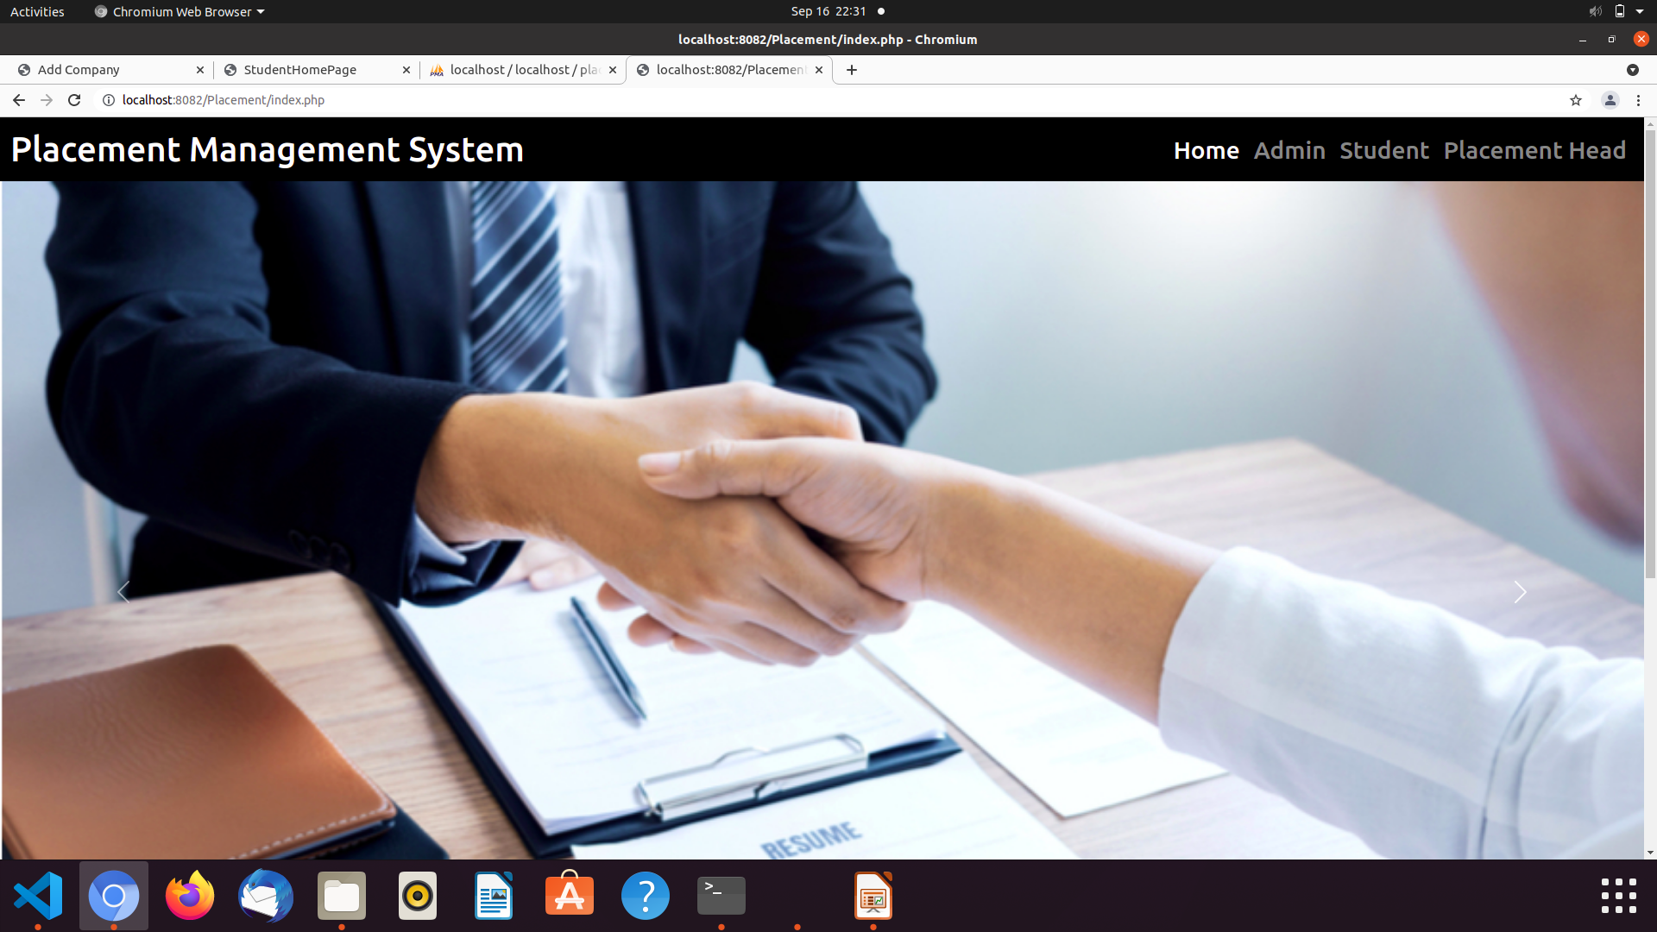
04
Output Screens
Home Page
16

Slide 17
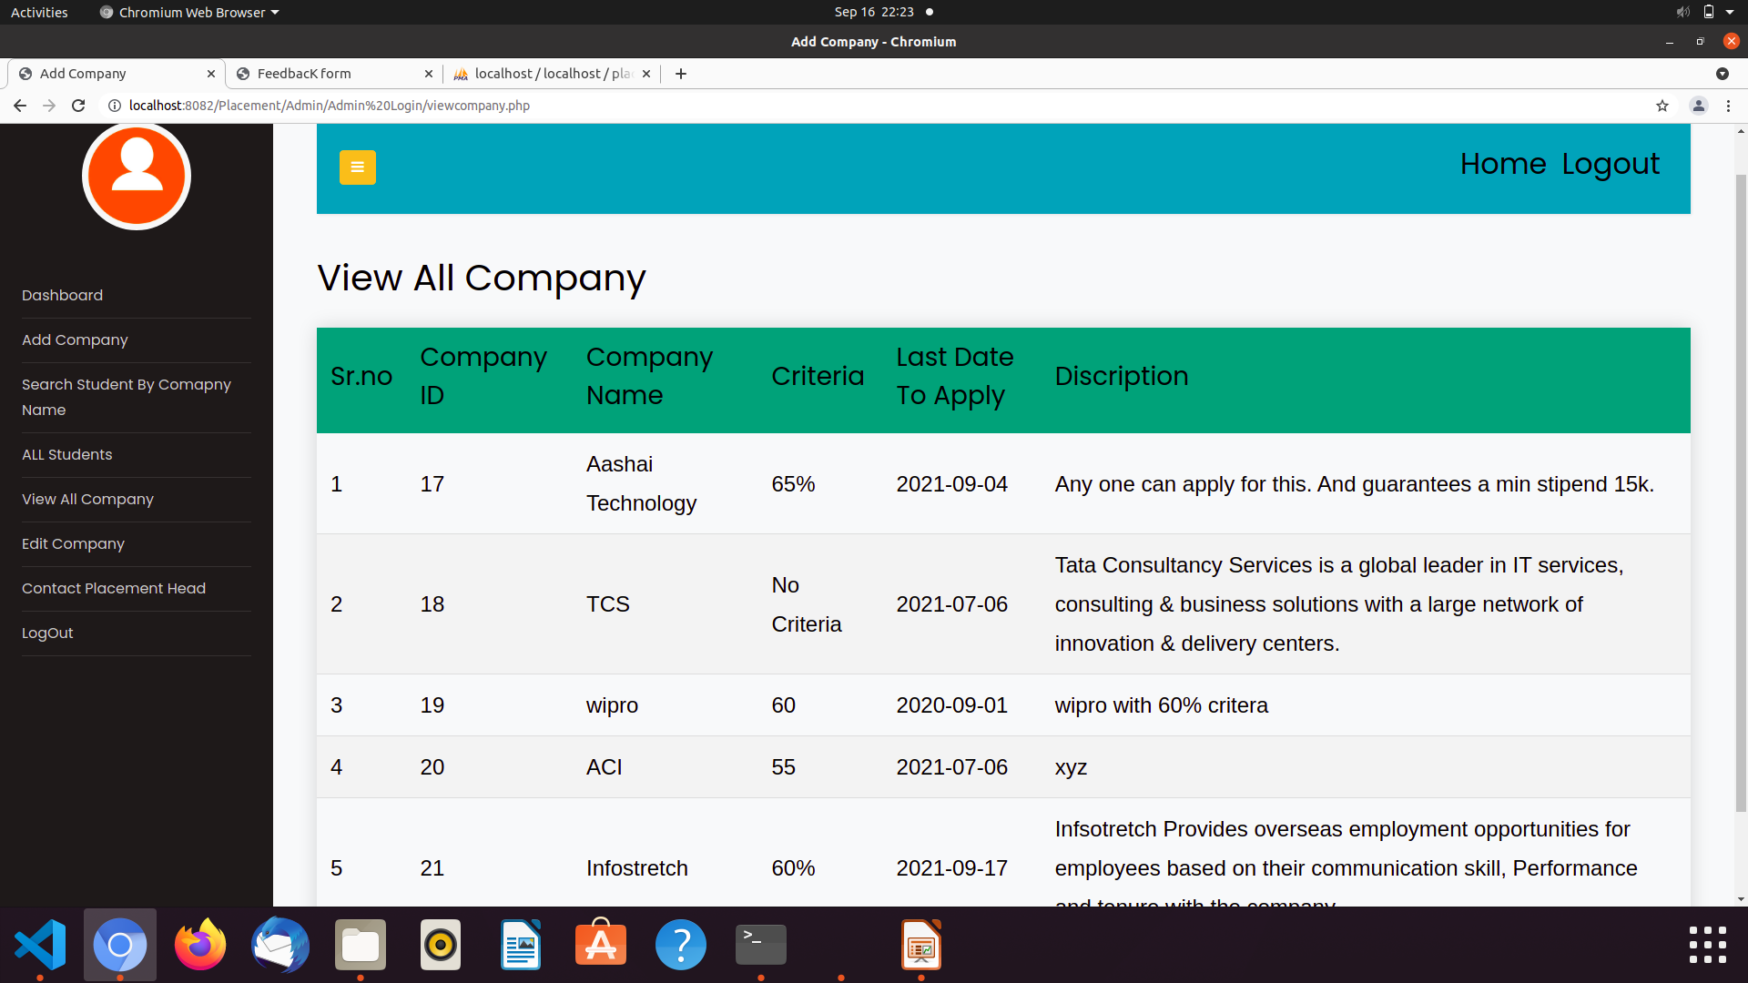
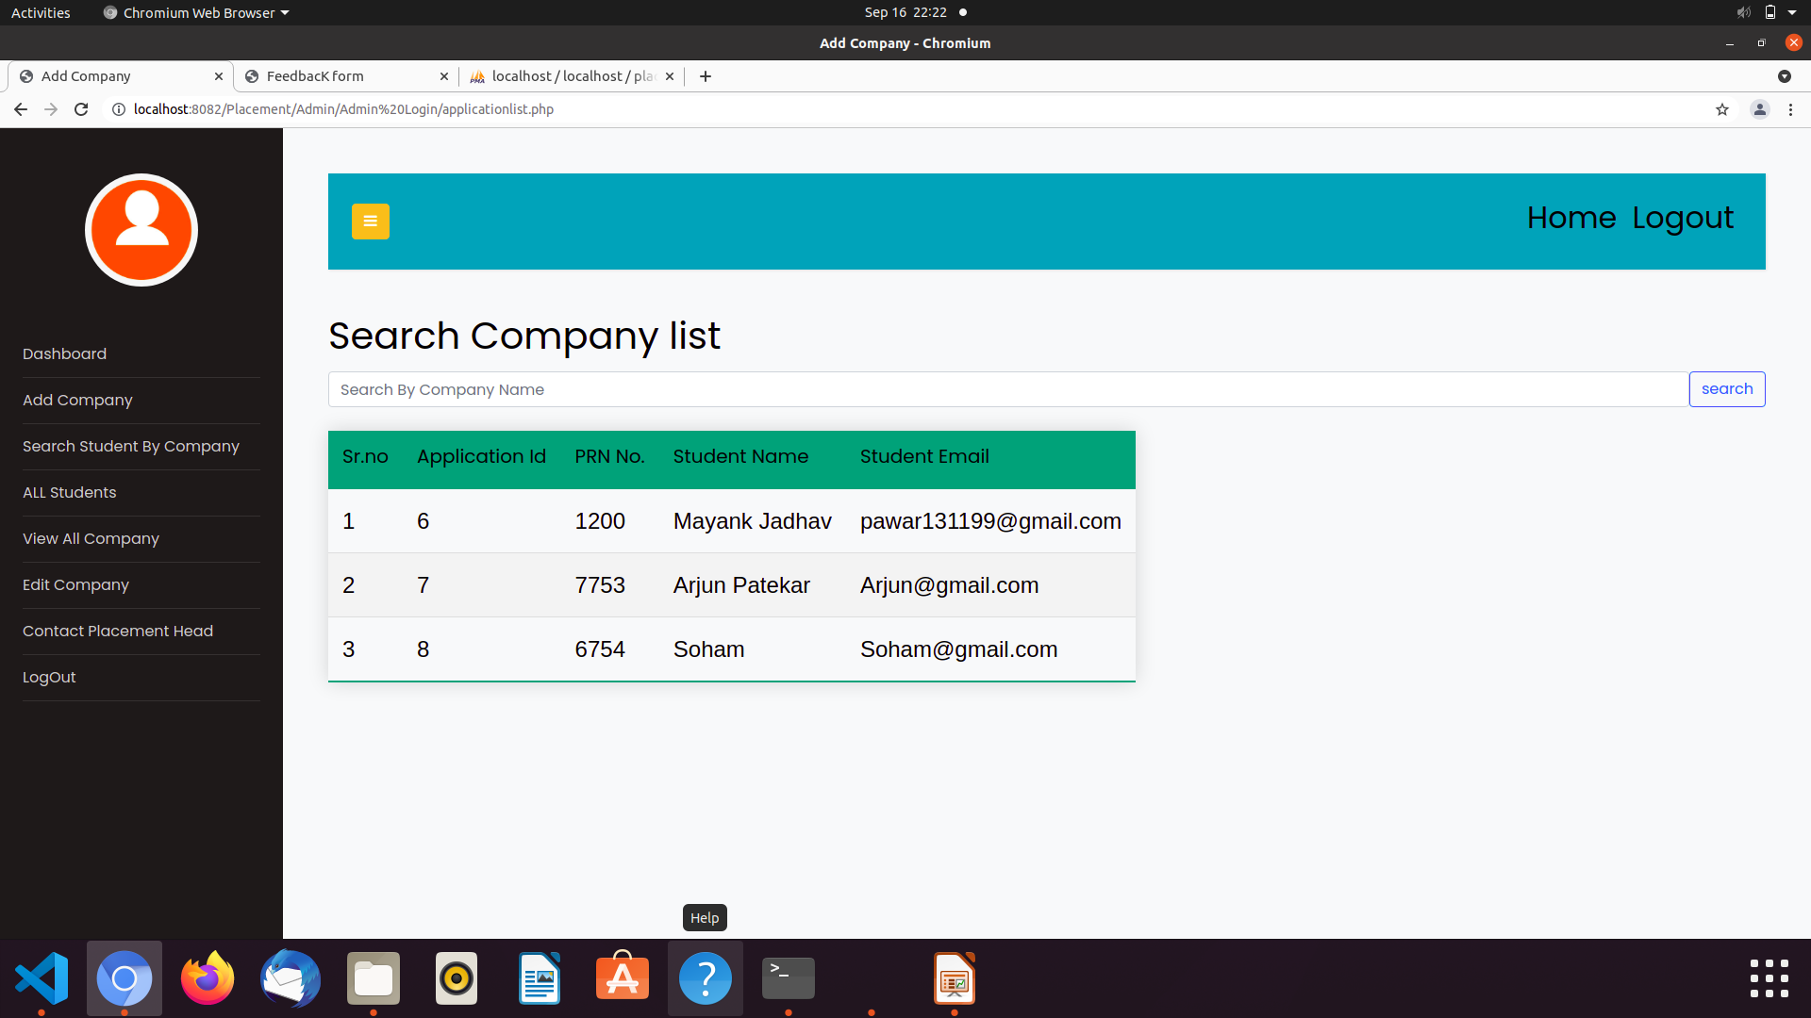
ADMIN
View All Company
Search Company
17

Slide 18
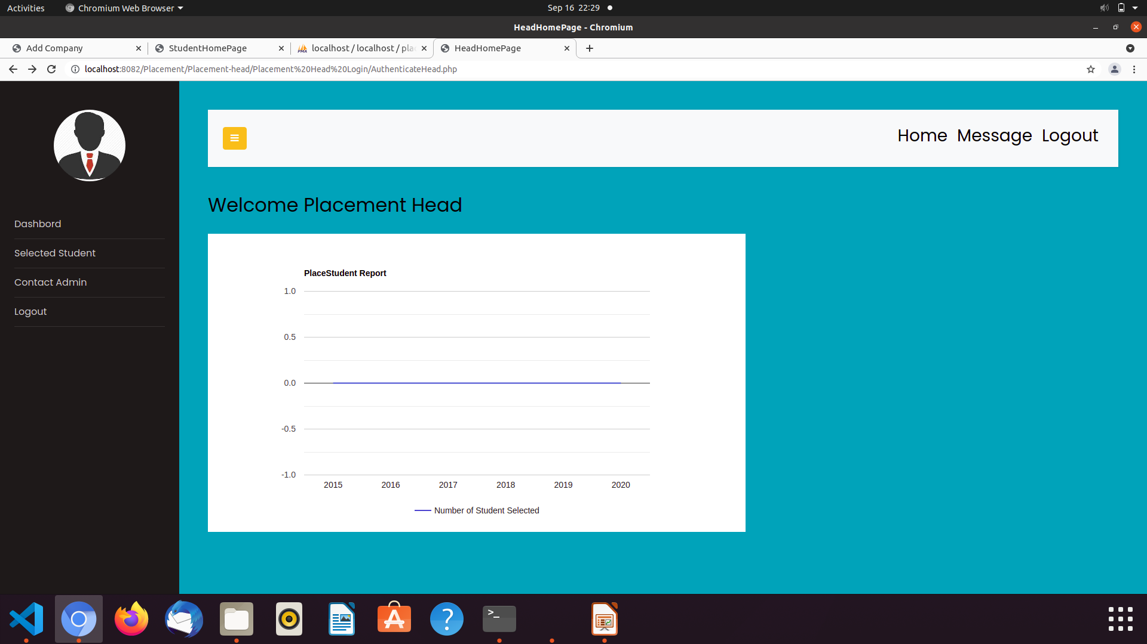
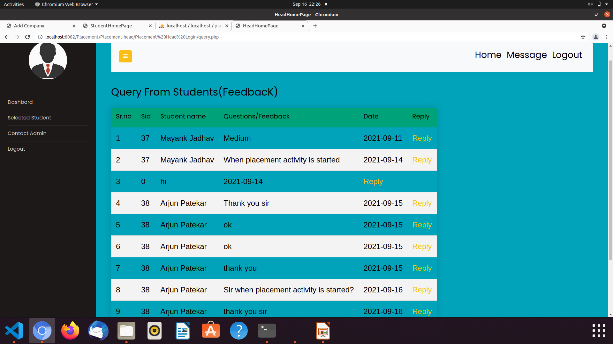
HEAD
Query From Student
Headhomepage

Slide 19
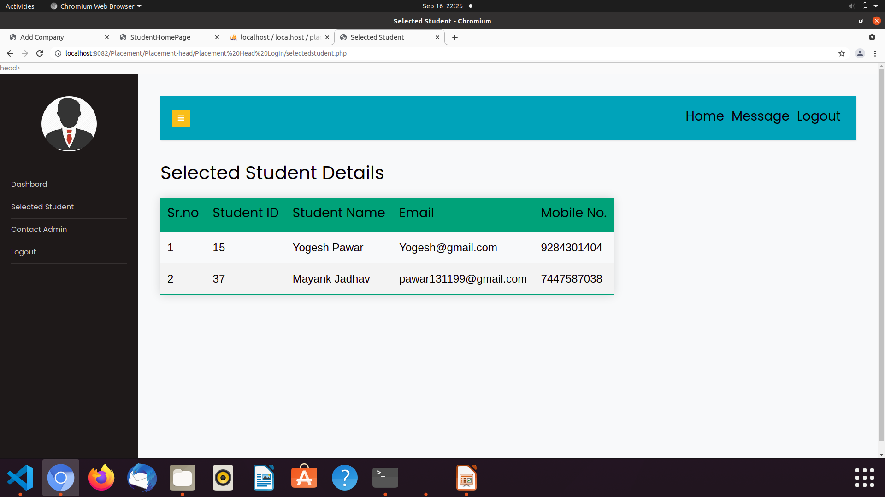
Selected Student

Slide 20
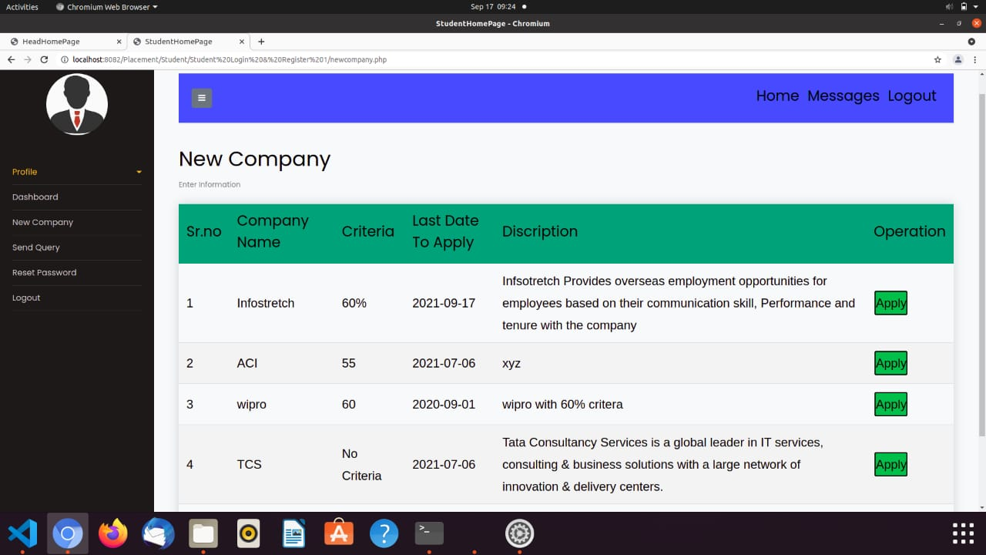
Student
New Company

Slide 21
06
Report
21

Slide 22
07
Limitation and Drawbacks
Limitation:-
Input should be given carefully.
Limited for small job portal purpose.
Monthly reports of selected students can be stored individually
Drawbacks:-
System Works in online mode only.
No Direct Communication with company.
22

Slide 23


8
Conclusion
The Problem definition of the project has been completed successfully to college web based placement management system by maintaining the student details related to placement in efficient manner.
23

Slide 24


09
Future Scope
Student can access previous information about placement.
We can stores information of all students. Various companies can access their information. Notification are sent to student about the company.
24

Slide 25
10
Bibliography
www.w3schools.com
www.stackoverflow.com
25

